Slide 1
Unlocking Our Potential in Asia Pacific
Allegion Investor Day
Indianapolis, IN
March 12, 2014

Slide 2
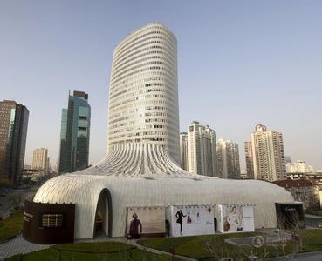
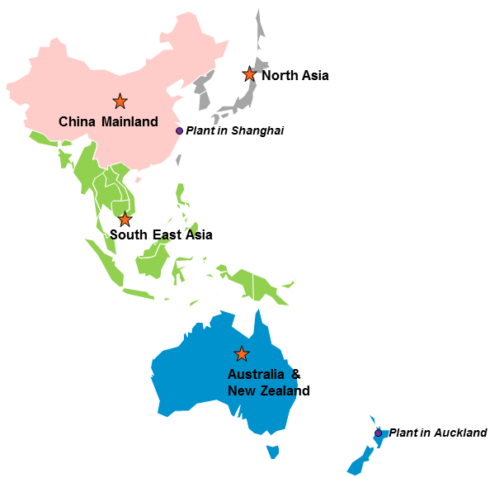
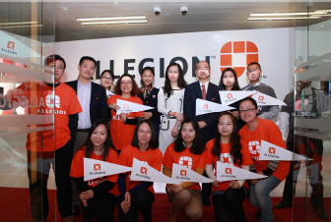

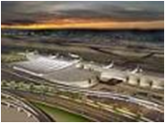
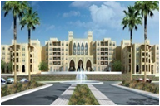


Who we are: Asia Pacific
Option 1
Our Growing Path
  1997: Started business in the region
  2003: Set up Asia Pacific organization
  2013: $150+M business across Asia Pacific
Shanghai Headquarter
Our Winning Team
  650+ employees
  25+ Offices
  2 plants in Shanghai, China and Auckland, New Zealand
Our Broad Offerings:
  Security products design, system integration, manufacturing, sales, after sales service, etc.
Allegion Day One Celebration
Consultation
Code Compliance
Our Loyal Customers
  350+ independent channel partners
  1000+ end user customers
  200+ architect firms
Transport
Hospitality
Fitness-For-Purpose
Value
Healthcare
Education
Notes:
Notes:
China HW China Bocom AP back office Jinshan Plant Korea HK SEA ANZ
Headcount # 84 284 71 89 2 17 10 122
Ave. years with Allegion 3.7 4.4 3.9 0.25 4.2 6.8 2.4 10.2
Branch Office: China 16 + AUS 4 + NZ 3 + SEA 3 + NA 2
NZ has a plant in Auckland which does Engineering/R&D, Assembly & some Machining.

Slide 3
Who we are: Asia Pacific
Option 2
Please help
Our Growing Path
  1997: Started business in the region
  2003: Set up Asia Pacific organization
  2013: $150+M business across Asia Pacific
Our Winning Team
  650+ employees
  25+ Offices
  2 plants in Shanghai, China and Auckland, New Zealand
Shanghai Headquarter
Allegion Day One Celebration
Consultation
Code Compliance
Transport
Hospitality
Fitness-For-Purpose
Value
Our Broad Offerings:
  Security products design, system integration, manufacturing, sales, after sales service, etc.
Our Loyal Customers
  350+ independent channel partners
  1000+ end user customers
  200+ architect firms
Healthcare
Education
Notes:
Notes:
China HW China Bocom AP back office Jinshan Plant Korea HK SEA ANZ
Headcount # 84 284 71 89 2 17 10 122
Ave. years with Allegion 3.7 4.4 3.9 0.25 4.2 6.8 2.4 10.2
Branch Office: China 16 + AUS 4 + NZ 3 + SEA 3 + NA 2
NZ has a plant in Auckland which does Engineering/R&D, Assembly & some Machining.

Slide 4

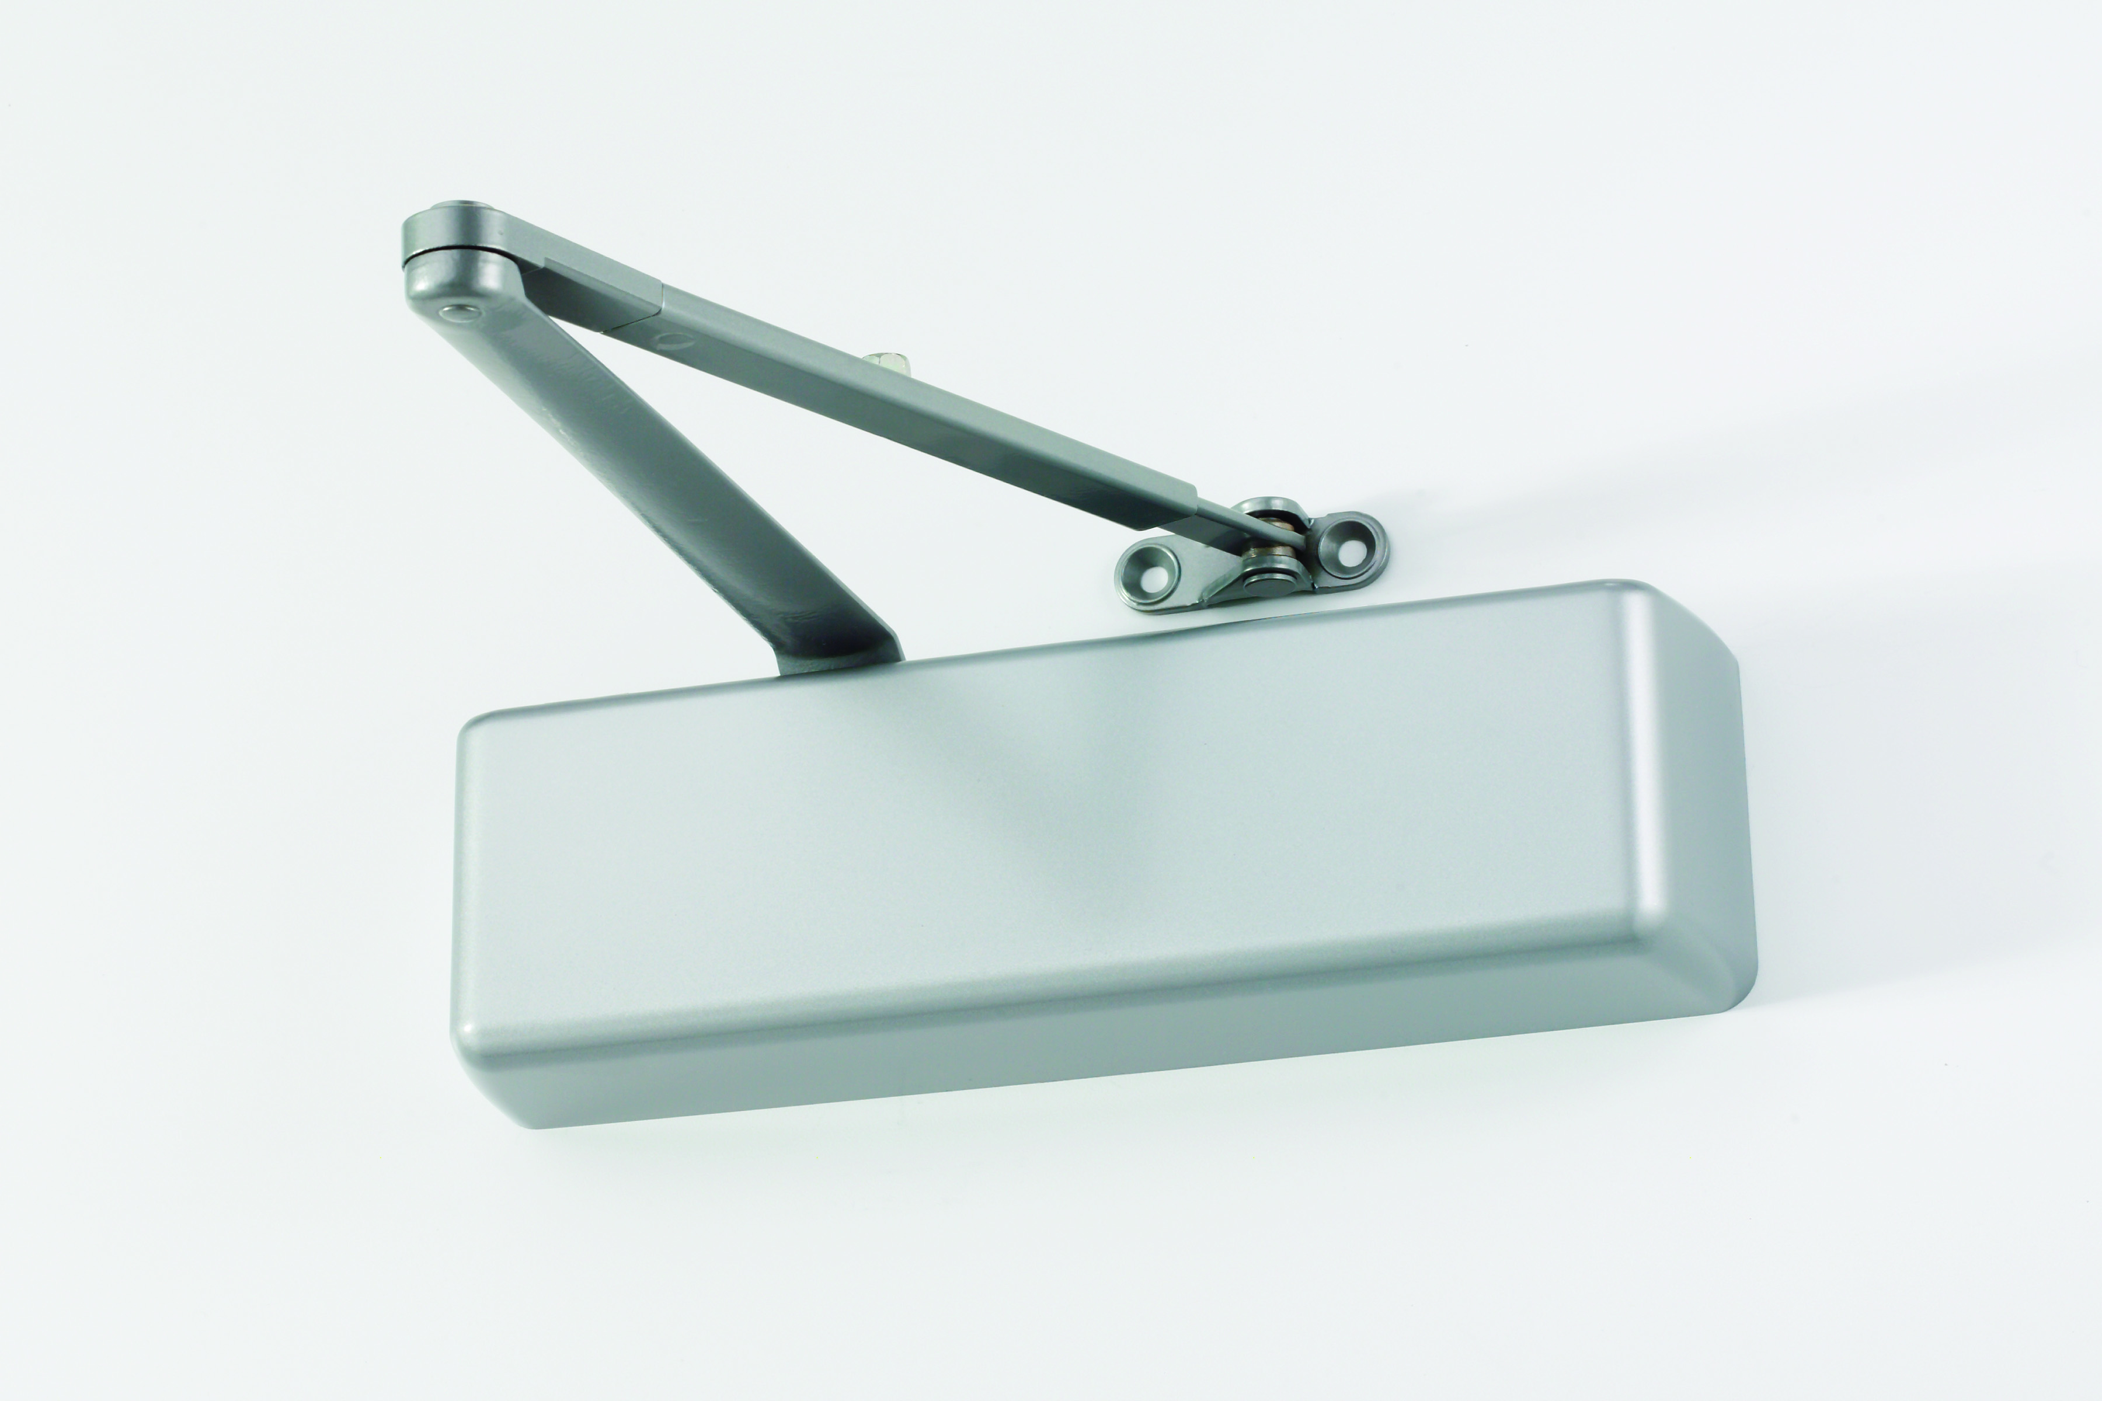




















What we sell: Asia Pacific
Mechanical Lock | Door Closer | Exit Device | Accessory | Electronic Lock | Electronic Access Control | System Integration
Brand

Slide 5





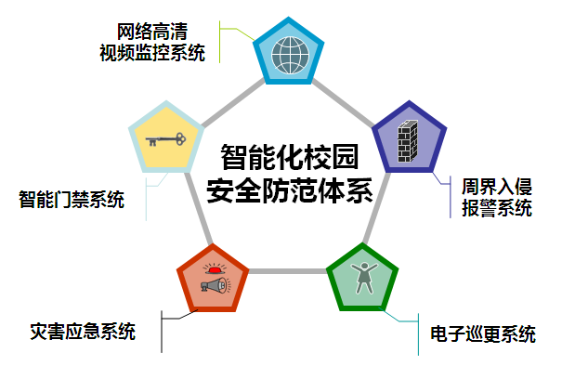
What we sell: Asia Pacific
Served Markets
Safe City
Airport
Metro
Healthcare
Education
Project Scope
  Key Capabilities
Video Surveillance System
  Decode customer requirement to tailored solutions
Design customized application interface
Optimized product configuration
Project management and supply chain management
Transferrable capability to serve new commercial verticals
Safe City Project
(As an example)
Vehicle Recognition System
Intelligent Traffic System
Alarming System
Integrated Management System
Bocom’s expertise at translating customer needs to integrated system solutions
Notes:
Notes:
Bocom Responsibilities in Safe City Project
Understand customer needs
Design customer application interface
Build up systems
Construction, product installation, service
General project management
Bocom Service Revenue:
2010 US$8.25M, 2011 US$13.25M, 2012 US$21.4M, 2013 US$26M, 2014 US$32M
Bocom Service Profitability
Bocom service gross margin is 19% which is quite similar to Bocom total gross margin, because most of the service is included in the initial project contract.
The on-site technical support(labor business) gross margin could be up to 26%.
It is 3 years on average before the customers have service demand, after the 3-year warranty is over. According to Bocom current install base, the service demand will increase with 30% growth rate. The equipment life cycle of 5~6 years, and the customers will probably launch another new construction project
Service impact on new business development:
Healthcare: At first, Allegion conducted on-site security assessment as consulting service and provide system-retrofit suggestion to the hospital. So far, Allegion has achieved $170K recurring revenue for system upgrade and service with future new project pipelines.
Beijing Airport: We provide on-site technical service to the airport with annual $600K service revenue, which also provides new construction project to Allegion as new project opportunities. -A $1.5M project of Beijing airport is being followed.

Slide 6
How we sell: Asia Pacific
Allegion
Wholesaler
Distributor
Decoration Company
Door Manufacturer
System Integrator
60%
Big Box
Online Store
Retailer
Developer
End User
100% of system integration business is under direct sales model
70% of hardware business is through distributors
Notes:
Notes:
For AP hardware business, we sell products primarily through distribution partners, who in turn sell to end users including both commercial and residential applications. We also sell directly to both Big Box (e.g. Masters, Bunnings, Placemakers, Mitre 10 and Carters in Australia and ITM in New Zealand. Masters is a JV between Lowe's & Woolworths in Australia, and the others are all local) and door fabricators. There are around 350 channel partners and more than 1000 end user customers within Asia Pacific.
For system integration business (mainly in China), we play as the general contractor for the majority projects. We have more than 100 customers in China mainland, and the largest customers are Public Security Department.

Slide 7
Where we are: Asia Pacific
Sales Territories in AP
China Mainland
North Asia
Branch before 2011
Branch after 2011
Plant
Plant in Shanghai
South East Asia
(China) | # of Branches | Served Population
Before 2011 | 4 | 67M
After 2011 | 21 | 212 M
Australia & New Zealand
Plant in Auckland
Geographic expansion to capture growth opportunities in 2nd & 3rd tier cities in
China and emerging countries in South East Asia
Notes:
Notes:
We have 4 offices in Australia and 3 in New Zealand.
For hardware business, there are around 350 channel partners and more than 1000 end user customers within Asia Pacific.
For system integration, we have more than 100 customers in China mainland.
SEA Offices:
The earliest is only Singapore and Malaysia for many year ,till thailand office open in yr 2010 follow by Japan office . As for Indonesia start office since 2012,

Slide 8
Asia Pacific market overview
2013 Addressable Market Size
by Product Category ( US$ M )
  Asia Pacific security markets continue to grow
  Transportation, healthcare, and industrial are the fastest growing vertical markets
  Opportunity for growth comes from urbanization, fast development of 2nd & 3rd tier cities
  Safety and security application extending to new verticals, e.g. healthcare, industrial, etc.
  Transition to electronic access for high end segment, especially in residential market
  Wireless door lock, RFID, biometrics identification, etc. urge the upgrade of access control devices and drive market adoptions
2013 Addressable Market Size
by Sales Territory ( US$ M )
China counts for the majority of the AP markets and leads the growth
* Data Source: Frost Sullivan Reports; NBS; Internal research
Notes:
Notes:
Product Category
Mechanical Access (AP): including products of Mechanical Lock, Closer, Floor Spring and Exit Device;
Electronic Access (AP): including products of Electronic lock and Access Control
System Integration (China only): including verticals of Public Security, Hospitality, Transportation, Plant and Healthcare
Data source: Global Insight, EIU, ANZ Building Approvals, KOB, IMS 2013 Report, internal market size model
Regional Market Trend
AP - Economic performance was subdued in Asia Pacific during 2012, while GPD growth is set to pick up gradually during 2013 to reach 6.3%. Leading by China, Asia Pacific will still remain as the fastest GDP growing region globally with CAGR 5.8% from 2014 to 2018.
China - Leading by Electronic Access growing at 22%, the total addressable market is expected to keep 16% growth during 2014-2018. The growth engine is mainly from the quick development of 2nd and 3rd tier cities.
SEA - Indonesia, Malaysia and Singapore are top 3 potential markets and mainly triggered by government investment.
ANZ - Australia remains the largest market in ANZ with growth at 4.5% during 2014-2018. New Zealand market is boosted by rebuild work after earthquake.
NA - New building construction in Korea, the largest market in NA, sees big drop since the beginning of 2013, and government stimulation is expected to be the key driver for future market rebound.

Slide 9
Our core strengths and gaps
Option 1
Market Segment Distribution
Core Strengths
Well-recognized brand image in niche ANSI Grade 1 market in China (30% market share)
Professional spec-in resources and capabilities
Strong brand awareness and extensive channel coverage in New Zealand
Software development and complex project management capabilities in Bocom business
Strategy
Expand product portfolio to penetrate in mid end market segment
Enhance M&A efforts
Premium
2%
High
6%
Middle
44%
Low
48%
Substantial opportunities exist in mid end market segment,
Efforts begin with acquisition for channel presence, lower-cost local products and brand
Notes:
Notes:
We estimate that total market for hardware business in Asia Pacific was approximately $2.4 billion in 2012. China mainland accounts for 78% of total market, or $1.9B in 2012.
The total market of system integration in mainland China is estimated at $11B in 2012. Safe city is the key vertical market, which accounted for 33% of total market with $3.6B in 2012. The primary factors driving this industry are from the demand of technology upgrade in 1st tier cities, and security application expansion as well as technology upgrade in low tier cities.
Other Gaps & Threats
Breadth of channels and customer access
Local design & manufacturing capabilities
Commercial vertical market capabilities and capital funding in Bocom business

Slide 10
Our core strengths and gaps
Option 2
Market Segment Distribution
Core Strengths
Well-recognized brand image in niche ANSI Grade 1 market in China (30% market share)
Professional spec-in resources and capabilities
Strong brand awareness and extensive channel coverage in New Zealand
Software development and complex project management capabilities in Bocom business
Strategy
Expand product portfolio to penetrate in mid end market segment
Enhance M&A efforts
Substantial opportunities exist in mid end market segment,
Efforts begin with acquisition for channel presence, lower-cost local products and brand
Notes:
Notes:
We estimate that total market for hardware business in Asia Pacific was approximately $2.4 billion in 2012. China mainland accounts for 78% of total market, or $1.9B in 2012.
The total market of system integration in mainland China is estimated at $11B in 2012. Safe city is the key vertical market, which accounted for 33% of total market with $3.6B in 2012. The primary factors driving this industry are from the demand of technology upgrade in 1st tier cities, and security application expansion as well as technology upgrade in low tier cities.
Other Gaps & Threats
Breadth of channels and customer access
Local design & manufacturing capabilities
Commercial vertical market capabilities and capital funding in Bocom business

Slide 11

Our growth strategy
Expand in
Core Markets
by establishing
thought leadership across the region
Opportunistic Acquisitions
to gain growth in mid end segment in China
Innovation in Existing and New Product Categories
  through localized engineering and integrated supply chain
Operational
Excellence
to achieve productivity and margin improvement
Growth in
Emerging Markets
through geographies, new vertical markets and channel expansion
Notes:
Notes:
Expand Market Coverage
Further expand geographical channel coverage into identified 2nd tier cities of China and emergent countries of SEA
Penetrate into emerging vertical markets
Optimize dealer network and improve dealer management
Accelerate M&A to penetrate into mid price point segment
Upgrade Offerings
Continuously enhance engineering and integrated supply chain capabilities for localized products improvement
Drive business growth in Electronics with upgraded products to meet customer needs
Improve service capability and extend service business portfolio
Be Thought Leader
Build expertise and brand awareness in identified verticals
Enhance consulting capabilities and position Allegion as Safety Advisor to customers
Establish the thought leadership through security and safety institute
Develop People
Enhance organization capability on software engineering and service
Cultivate business talents with systematic training programs, e.g. Business Manager Development Program

Slide 12



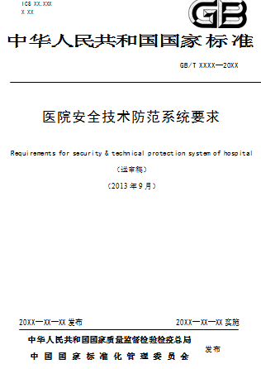





Growth through establishing the thought leadership
Safety & Security Institute
Committed to promote innovation, drive technology development and raise public awareness on Safety and Security
Safety & Security College
Reputable platform for learning and development for EVERYBODY; devotes effort to society safety and security
Market Report
Code Development
Promotion
Education
Alliance
Hospitality report
Education report
Healthcare/campus audit report
US vs. China code comparison
Under the name of safety and security institute, Allegion is the only foreign company involved in the development of China 1st healthcare security code
Innovative social promotion
53,000+ subscribers of E-newsletter
4680+ followers on Chinese twitter
1800+ monthly visitors of SSI website
Textbook on Architecture Security Technology
Elective courses in multiple leading universities
Alliance with associations, key accounts, vertical market partners, etc.
Strategic partnership with leading universities
Positioning and establishing thought leader as one of the differentiators
Notes:
Notes:
Code Involvement
How to involve
-Pay attention to code adapted
-Customer voice collection
-Drive and cooperation with organizer
-Code draft and review
How to influence
-Code gap analysis
-Audit and explore vulnerability by code
-Int’l code promotion and import
Impact on Allegion
-Influence industrial standard and national code
-Influence specification in project earlier phrase
-Impact on customer budget allocation
-Benefit customer identification
-Consolidate thought leadership
“2011-2013 Requirements for security & technical protection system of hospital”
-Successfully introduced security and safety audit
-Expected to launch in 2014
-Exclusive foreign company in the industry with expertise of SSI
-Wide promotion of Allegion in expertise in life safety and security, and planning, budgeting etc.
“2011-2013 Requirements for security & technical protection system of hospital“
-Successfully introduced security and safety audit
-Expected to launch in 2014
-Exclusive foreign company in the industry with expertise of SSI
-Wide promotion of Allegion in expertise in life safety and security, and planning, budgeting etc.
SCVST: Shanghai Vocational College of Science & Technology
Security system design
College courses development
Show room design and decoration
Internship base

Slide 13
Growth through BOCOM business
Market potential driven by
the development of 2nd & 3rd tier cities
(2015)
Growth Strategy
  Geographic expansion
  Capture growth opportunities in 2nd & 3rd cities
  Penetration into new vertical markets
  Develop tailored vertical market system integration platform
  Leverage hardware products and channels to increase system integration project opportunities
  Grow service business
  35% CAGR in the past 3 years
  Extend service offerings, including customized software, retrofit upgrade, system extension and maintenance service
  Optimized and standardized service delivery process
  Service team capability built up
$Mn
≥300
(150-300)
≤150
  Key growth drivers
  Development of 2nd & 3rd tier cities driven by urbanization
  System integration application extended to new vertical markets
  More sophisticated customer needs and increasing install base
Notes:
The total market of system integration in mainland China is estimated at $11B in 2012. Safe city is the key vertical market, which accounted for 33% of total market with $3.6B in 2012. The primary factors driving this industry are from the demand of technology upgrade in 1st tier cities, and security application expansion as well as technology upgrade in low tier cities.
Service impact on new business development:
Healthcare: At first, Allegion conducted on-site security assessment as consulting service and provide system-retrofit suggestion to the hospital. So far, Allegion has achieved $170K recurring revenue for system upgrade and service with future new project pipelines.
Beijing Airport: We provide on-site technical service to the airport with annual $600K service revenue, which also provides new construction project to Allegion as new project opportunities. -A $1.5M project of Beijing airport is being followed.

Slide 14
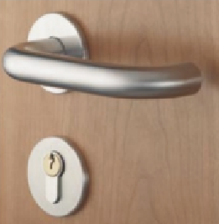

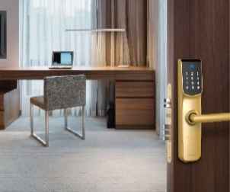
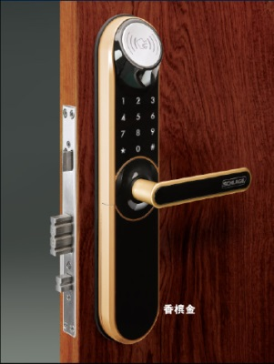
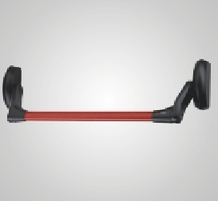
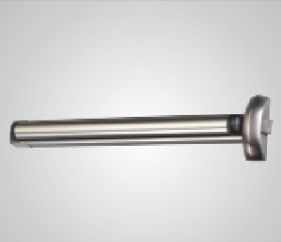
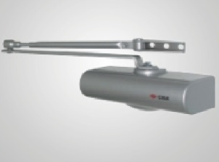
Innovation in new product development
2013 New Product Pipeline
2014 New Product Pipeline
AP New Product Revenue
Mechanical Lock
43%
Mechanical Lock
25%
Electronic Lock
Electronic Lock
2011
2012
2013
New product development through local sourcing and manufacturing, local design and OEM
  Continuously enhance engineering and integrated supply chain capabilities for localized products improvement
  Drive business growth in electronics with upgraded products to meet customer needs
Exit Device
Exit Device
Door Closer
Progressive new product localization driving innovation
Notes:
Notes:
It’s one of 2013 strategic initiatives to enhance engineering and integrated supply chain capabilities for localized products improvement and in-house development. We focus more on long-term organization capabilities improvement than quick revenue from OEM products.
AP New Product Revenue
2011Rev. $12.8M
2012Rev.$16.0M
2013ERev.$22.9M

Slide 15
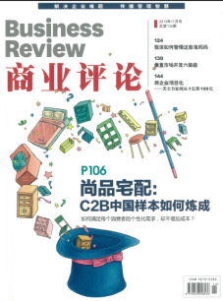









Growth in emerging vertical markets
Please help
Go-to-market Approach
Identify New Vertical Market Opportunity
Understand Customer Needs
Improve Awareness
Develop VM
Specific Solution
Expand Channel Network
Market Penetration
The Allegion VM approach published through “Business Review” magazine with 90,000+ readers.
Traditional Vertical
Emerging Vertical
Airport
Metro
Hospitality
Healthcare
Plant
R&D Center
Residential
Commercial Building
Education
Nuclear Power
Banking
Safe City
Dramatic YOY growth has been achieved in both traditional and emerging vertical markets,
e.g. hospitality(40%) and healthcare(70%) in 2013

Slide 16
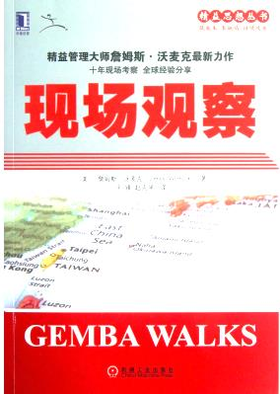

Margin improvement through operational excellence
Please help
1
Leverage US know-how and expertise to apply lean operation in Asia Pacific
1
2
Bocom Lean Transformation
2
3
Improve customer satisfaction through lead time and quality improvement
4
3
5
4
Global sourcing platform to achieve scalability and better serve AP and global markets
“Gemba Walks”,
introduced first time in China by Allegion in its Chinese version
5
Continuous focusing on productivity and margin improvement
Notes:
Notes:
Lean Transformation: Support Bocom Lean transformation
-Finish strategy A3
-Facilitate monthly review
-Finish SI VSM
Communication: Build up Opex culture
-Sharepoint redesign and update
-Monthly submit article to Locker
-MCB/Opex Communication Board update
-Quarterly Opex Best Practice Sharing Event
-Annual Award Event
-Reading Club (2 books each quarter)
People Development Develop
-SI Opex Leader
-Opex Leader
-AP Opex Leader
-Improve Employee engagement by 2 points through career dialog

Slide 17
Acquisition-led growth strategy focusing on the mid-end segment in China
Please help
Attractive Opportunity
Strategic Benefits
Market Potentials:
Attractive US$760M market and 15% growth with 30% gross margin and fragmentation
~65% of MPP is residential
Allegion Opportunity:
  Potentially multiple acquisitions to establish scale across channel, brand, product and operation
  Establish a MPP manufacturing COE quickly to serve AP and global markets
  Acquire an entry platform for residential market and MPP project segment
Quickly establish channel presence, low cost products and local brands
Channel
  Relationships with players in key channels, e.g. top developers, wholesalers and retailers
  Manufacturing
Local design and manufacturing
A wide breadth of products, and must match Chinese consumer preferences
Improve cost position through local manufacturing
Participate, build and enhance the integrated supply chain through lean
Brand
  Strong local brands with market perception of creditability and quality
A clear strategy with disciplined approach enables strong project pipeline, and rationale & efficient evaluating process

Slide 18
Asia Pacific Summary
Continuous strong market growth driven by urbanization, 2nd and 3rd tier city development, and increasing safety and security solution adoptions in new verticals
Prestigious brands, innovative products, professional spec in resources and capabilities create the key differentiators to drive high and premium markets
Bocom provides top line growth opportunity with opportunity to expand in service
Expand market coverage to capture the fast growing opportunities in new verticals and geographies
Enhance position through thought leadership to drive code development, market awareness, and business demands
Leverage premium position and extend to the substantial mid-end market in China through acquisition
Focus on margin improvement through operational excellence, localization and productivity

Slide 19


